Slide 1
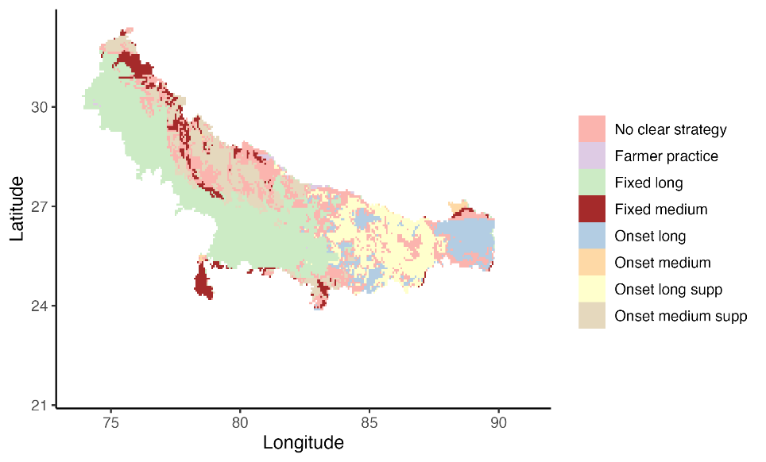
Risk-based evaluations of competing agronomic climate adaptation strategies: The case of rice planting strategies in the Indo Gangetic Plains
Motivation
Incorporate climatic risk and farmer risk aversion considerations in making scenario recommendations from crop growth simulation models
What are the spatially differentiated rice-wheat system level optimal (profit maximizing) strategies for sowing rice under climatic risk such that even a risk averse farmer finds it beneficial?
Research question
Model input
APSIM spatially gridded crop model results,
Interpolated irrigation costs and output prices
Model algorithm
Link expected utility theory risk aversion conditions to second order stochastic dominance (SOSD) and grid search algorithm
Model output:
Optimal rice sowing strategy for a risk-averse farmer under climatic risk

